Slide 1
Question 1
With reference to the figure above, describe Micron’s role in today’s chip shortage situation and how Micron has been impacted in no more than 800 words.

Slide 2
Micron’s role in today’s semiconductor shortage

Slide 3

Manufacturing step: 3-4 months

Slide 4
R&D
Innnovate processes

Slide 5
Impacts on Micron

Slide 6
Positive Impact
Demand increases greater than supply
Micron will be able to charge higher price
Total revenue will increase

Slide 7
Positive impacts
Shortage catches the attention of Singapore’s Government
Ambition to grow across value chain
Favorable policies
Stronger ecosystem for chipmakers like Micron

Slide 8

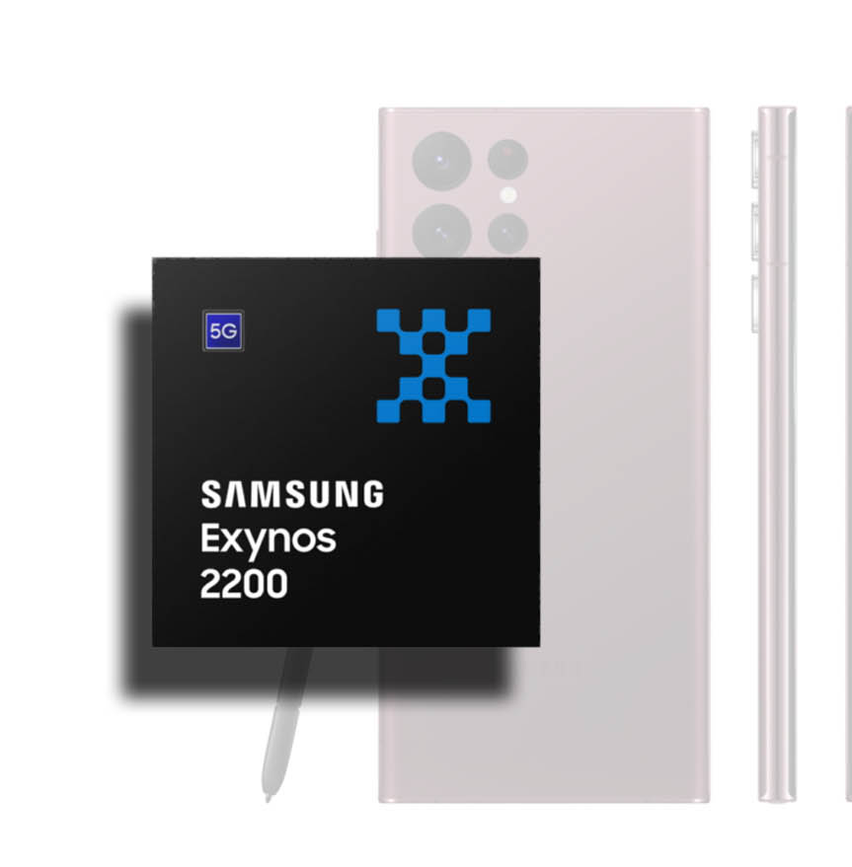
Negative impacts

Slide 9
Negative impacts

